Slide 1




HOTEL BOOKING
PROJECT
Presented by: Bhrat Sharma

Slide 2

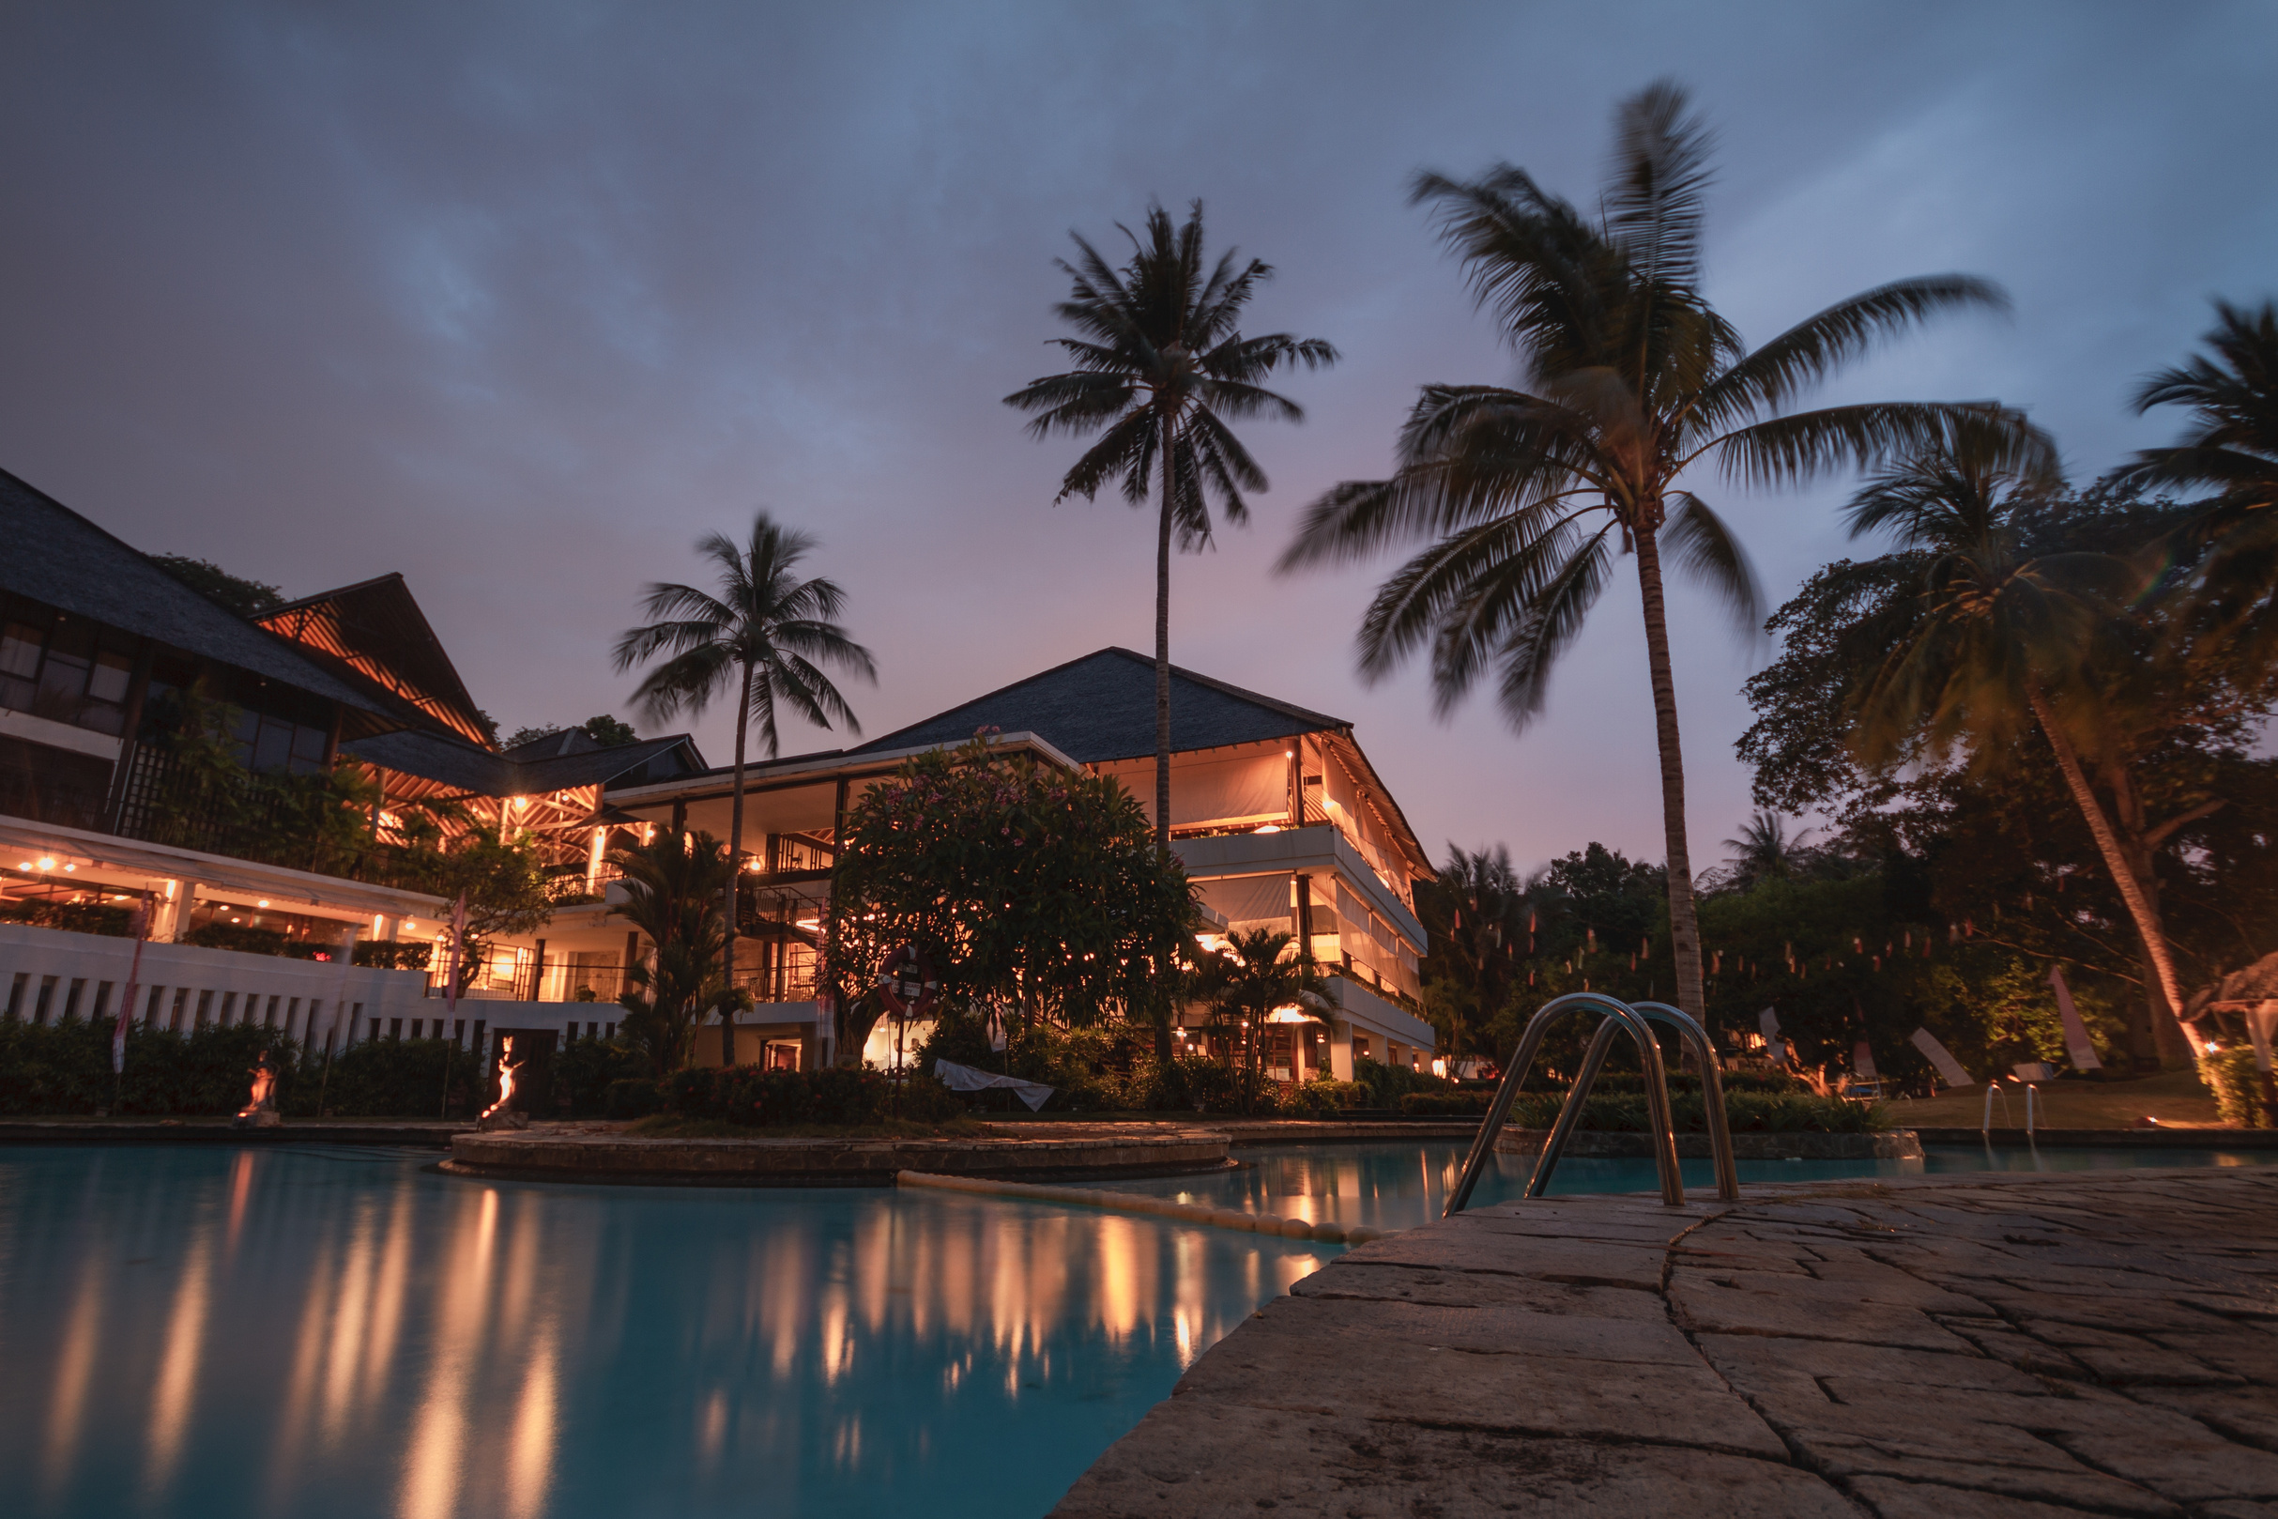

Objective
Perform comprehensive data analysis
Derive insightful information
Furnish the hotel with valuable insights
Enhance revenue generation
Effectively tackle prevailing challenges
Facilitate strategic resolutions

Slide 3
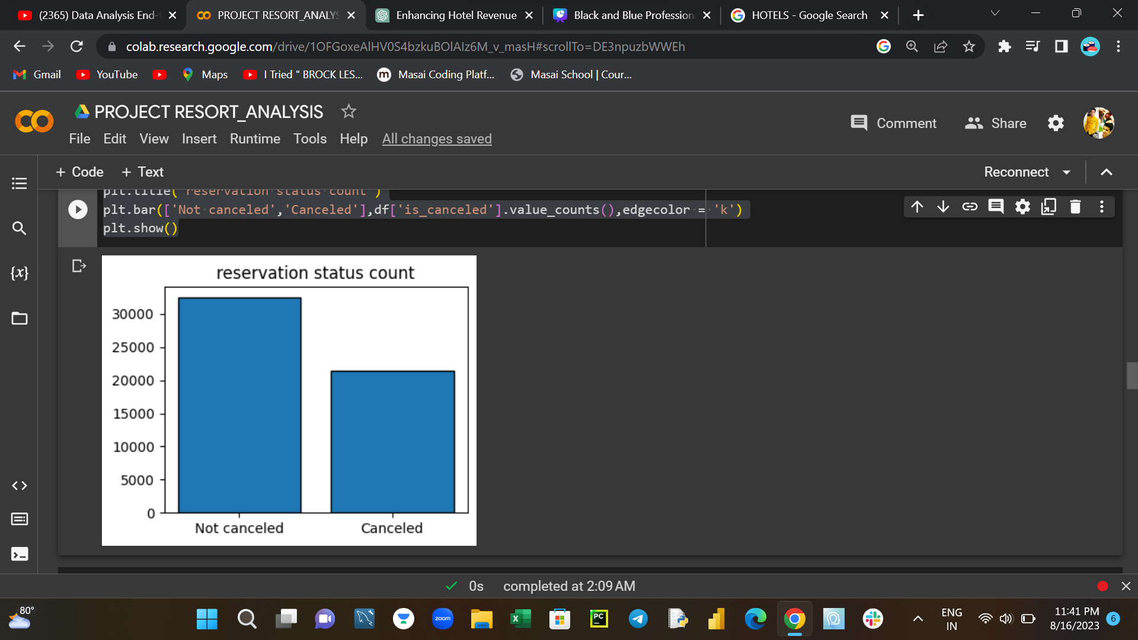
Reservation status count
Analysis of the bar graph reveals a conspicuous trend: a notable increase in the frequency of hotel cancellations.
This heightened occurrence of cancellations points to a critical concern demanding urgent attention.
The situation underscores the necessity for immediate and strategic intervention to address this issue effectively.

Slide 4
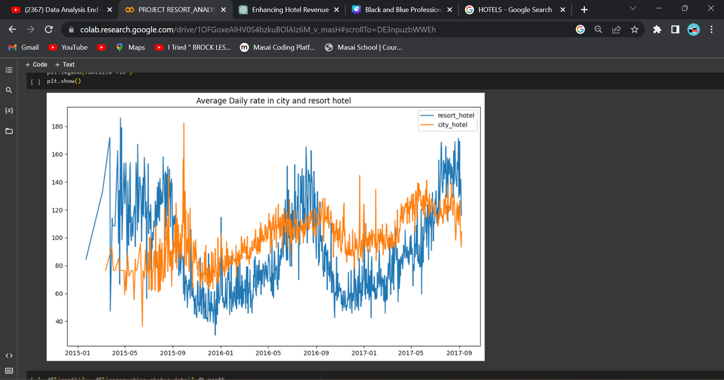
Average daily rate city vs resort hotel
Blue line: Represents resort hotel
Orange line: Represents city hotel
Clear trend: Resort hotel's higher average daily rate leads to lower bookings compared to city hotel.

Slide 5
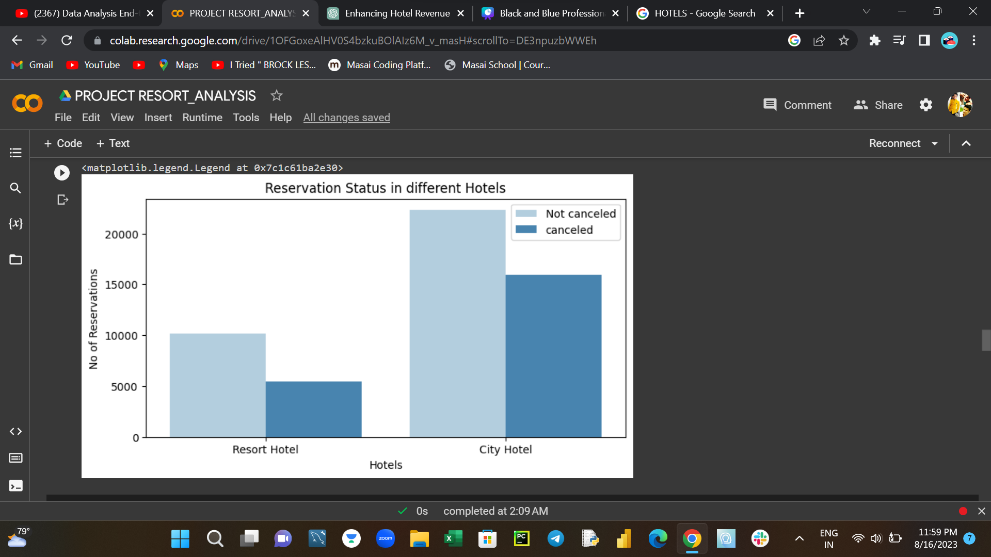
Reservation status in differnt hotels
The bar graph highlights a noticeable discrepancy in booked and canceled reservations.
City hotels show a higher count in both booked and canceled reservations compared to resort hotels.

Slide 6
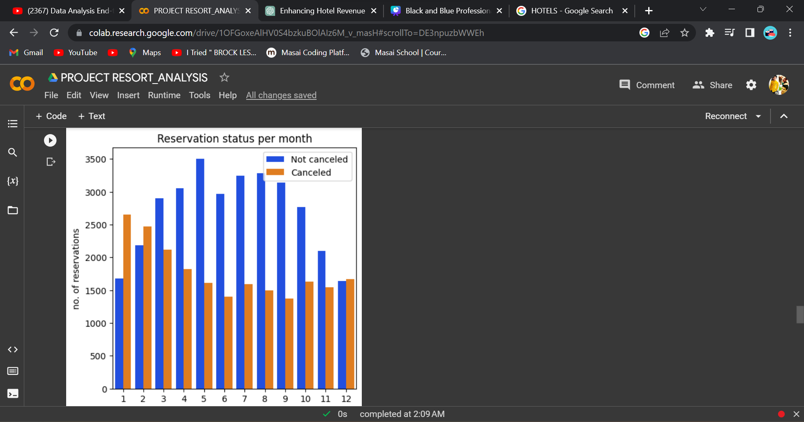
Reservation status per month
The bar graph reveals a clear pattern:
Mid-year months (April, May, June, July, August, September) exhibit heightened booking activity and reduced cancellations.
Initial and final months experience decreased bookings, potentially alongside comparable or increased cancellation rates.

Slide 7
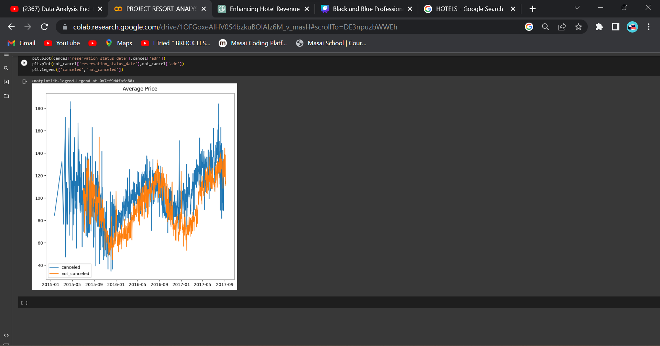
Average price per day for cancelled vs not canceled bookings
The visualization features two lines:
The blue line represents the average daily price for canceled bookings.
The orange line signifies the average daily price for bookings that were not canceled.
A notable finding is evident:
The average daily price for canceled bookings exceeds that of non-canceled bookings.
This unequivocally highlights the role of pricing as a discernible factor influencing the occurrence of booking cancellations.

Slide 8
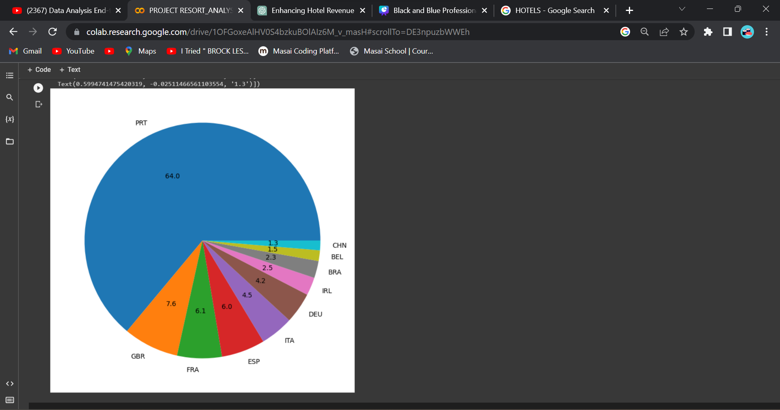
Top 10 countries with the most number of cancelations
The pie chart provides a focused perspective on cancellation trends:
It specifically encompasses data from the top 10 countries with the highest cancellation rates.
Notably, Portugal stands out as a primary contributor, accounting for a significant 64% of the total cancellations.

Slide 9
Suggestions
Consider reducing the pricing of the resort hotel to incentivize higher bookings and attract more customers to choose this option.
Carefully examine the elevated pricing rates that appear to contribute to increased cancellations.
Introduce enticing offers during the initial and concluding months of the year to attract a larger customer base during these periods.
Allocate resources to enhance the infrastructure and facilities of hotels located in Portugal, addressing the high cancellation rates observed in this country.

Slide 10
THANK YOU
For watching this presentation

